Slide 1

Chapter 18
Security at the
Network Layer: IPSec
18.<number>
Copyright © The McGraw-Hill Companies, Inc. Permission required for reproduction or display.

Slide 2
Chapter 18
Objectives
❏ To define the architecture of IPSec
❏ To discuss the application of IPSec in transport and
tunnel modes
❏ To discuss how IPSec can be used to provide only
authentication
❏ To discuss how IPSec can be used to provide both
confidentiality and authentication
❏ To define Security Association and explain how
it is implemented for IPSec
❏ To define Internet Key Exchange and explain how
it is used by IPSec.
18.<number>

Slide 3
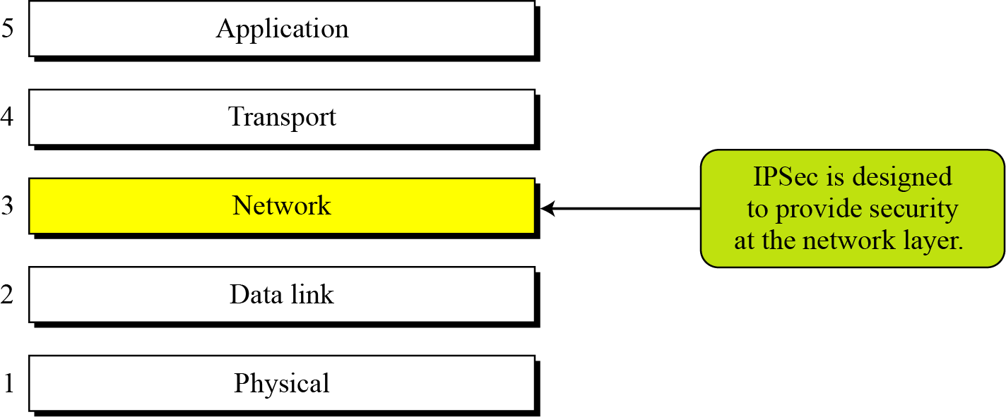
Chapter 18 (Continued)
Figure 18.1 TCP/IP Protocol Suite and IPSec
18.<number>

Slide 4
18-1 TWO MODES
IPSec operates in one of two different modes: transport mode or tunnel mode.
Topics discussed in this section:
18.1.1 Transport Mode
18.1.2 Tunnel Mode
18.1.3 Comparison
18.<number>

Slide 5

18.1.1 Transport Mode
In transport mode, IPSec protects what is delivered from the transport layer to the network layer.
Note
IPSec in transport mode does not protect
the IP header;
it only protects the information
coming from the transport layer.
18.<number>

Slide 6
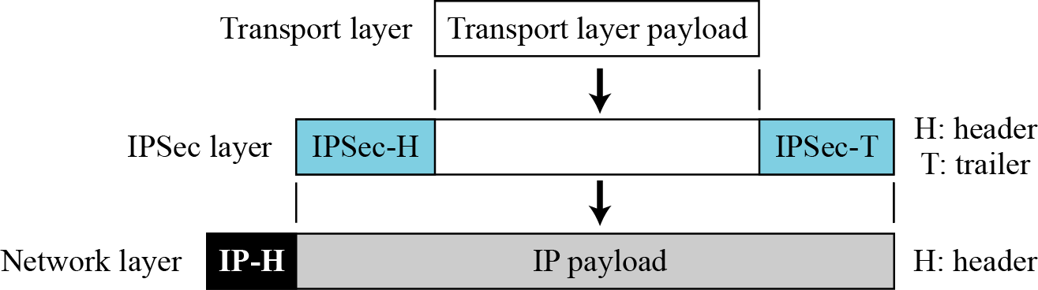
18.1.1 (Continued)
Figure 18.2 IPSec in transport mode
18.<number>

Slide 7
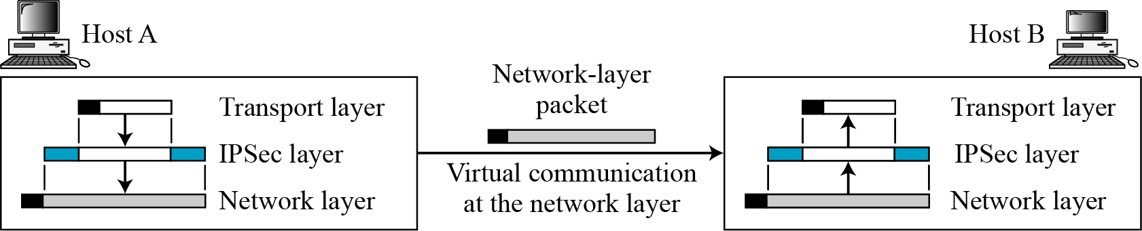
18.1.1 (Continued)
Figure 18.3 Transport mode in action
18.<number>

Slide 8
18.1.2 Tunnel Mode
In tunnel mode, IPSec protects the entire IP packet. It takes an IP packet, including the header, applies IPSec security methods to the entire packet, and then adds a new IP header.
Note
IPSec in tunnel mode protects the original IP header.
18.<number>

Slide 9
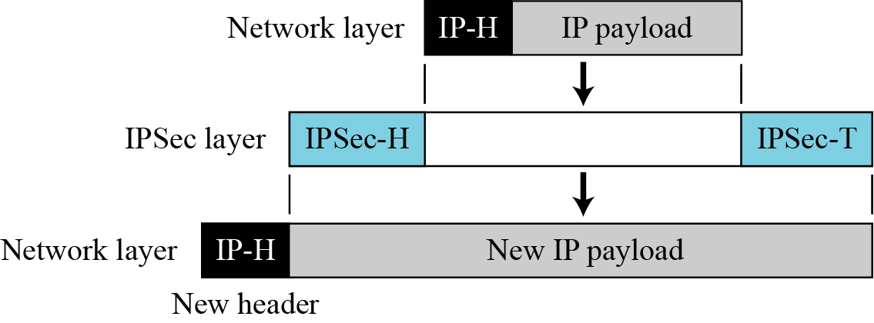
18.1.2 (Continued)
Figure 18.4 IPSec in tunnel mode
18.<number>

Slide 10
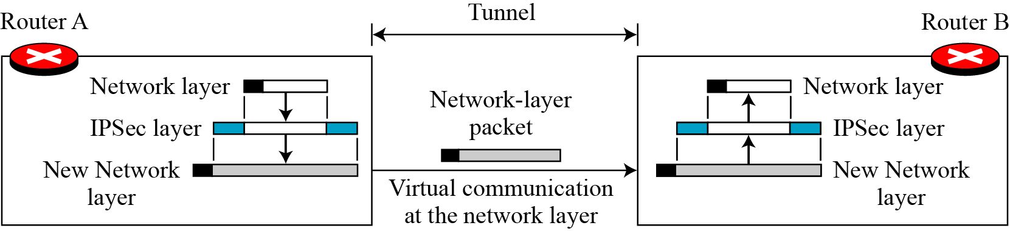
18.1.2 (Continued)
Figure 18.5 Tunnel mode in action
18.<number>

Slide 11
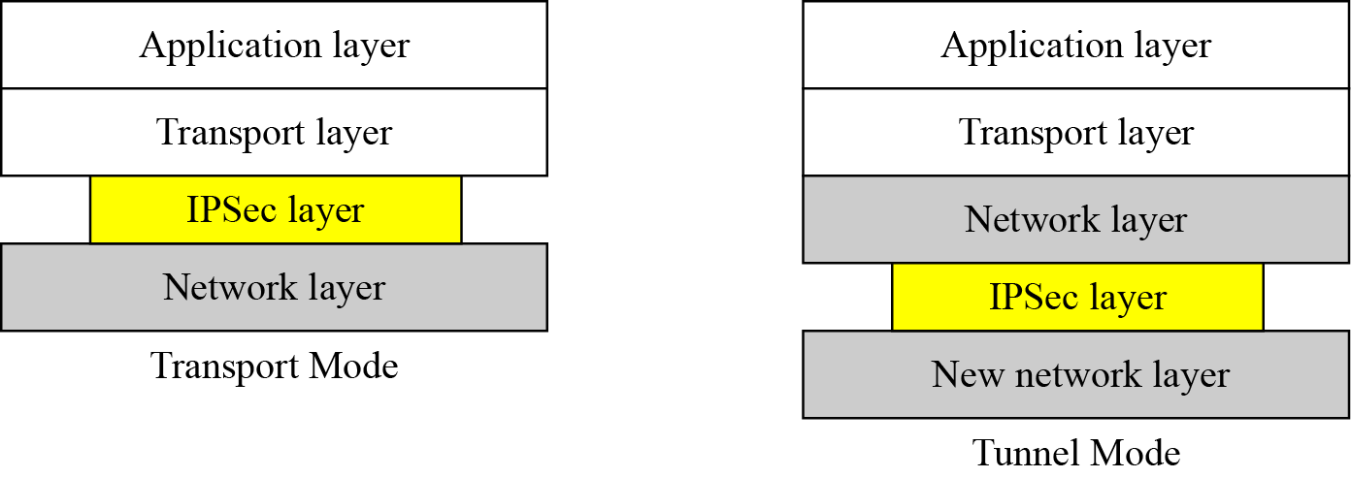
18.1.3 Comparison
Figure 18.6 Transport mode versus tunnel mode
18.<number>

Slide 12
18-2 TWO SECURITY PROTOCOL
IPSec defines two protocols—the Authentication Header (AH) Protocol and the Encapsulating Security Payload (ESP) Protocol⎯to provide authentication and/or encryption for packets at the IP level.
Topics discussed in this section:
18.2.1 Authentication Header (AH)
18.2.2 Encapsulating Security Payload (ESP)
18.2.3 IPv4 and IPv6
18.2.4 AH versus ESP
18.2.5 Services Provided by IPSec
18.<number>

Slide 13
18.2.1 Authentication Header (AH)
Note
The AH protocol provides source authentication and data integrity,
but not privacy.
18.<number>

Slide 14
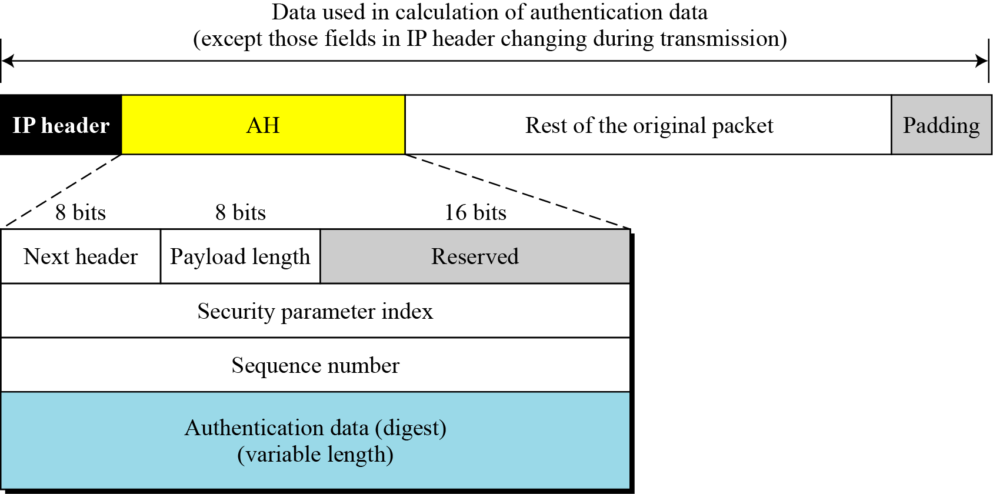
18.2.1 (Continued)
Figure 18.7 Authentication Header (AH) protocol
18.<number>

Slide 15
18.2.2 Encapsulating Security Payload (ESP)
Note
ESP provides source authentication, data integrity, and privacy.
18.<number>

Slide 16
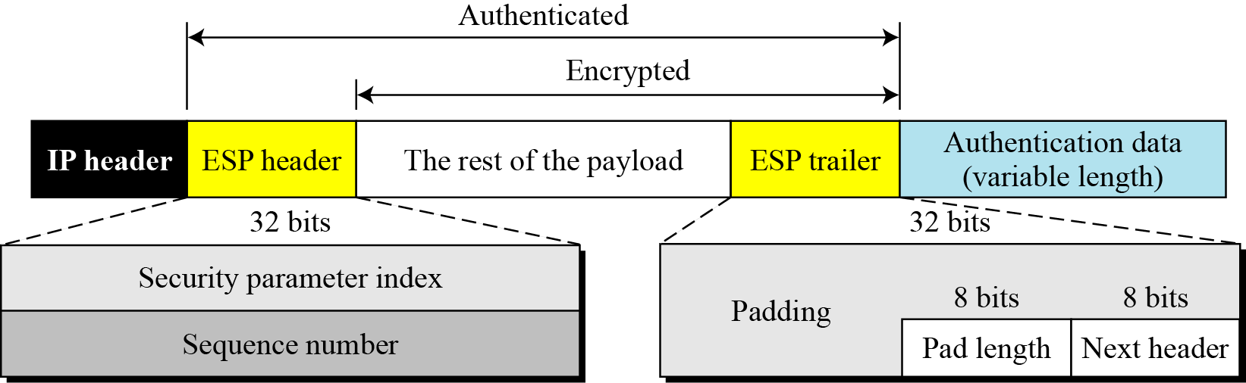
18.2.2 (Continued)
Figure 18.8 ESP
18.<number>

Slide 17
18.2.3 IPv4 and IPv6
IPSec supports both IPv4 and IPv6. In IPv6, however, AH and ESP are part of the extension header.
18.<number>

Slide 18
18.2.4 AH versus ESP
The ESP protocol was designed after the AH protocol was already in use. ESP does whatever AH does with additional functionality (privacy).
18.<number>

Slide 19
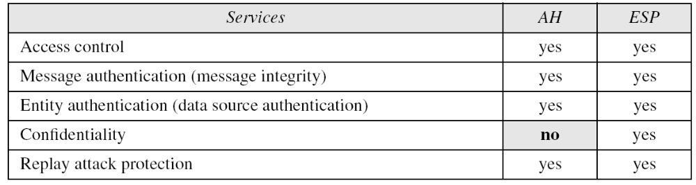
18.2.5 Services Provided by IPSec
Table 18.1 IPSec services
18.<number>

Slide 20
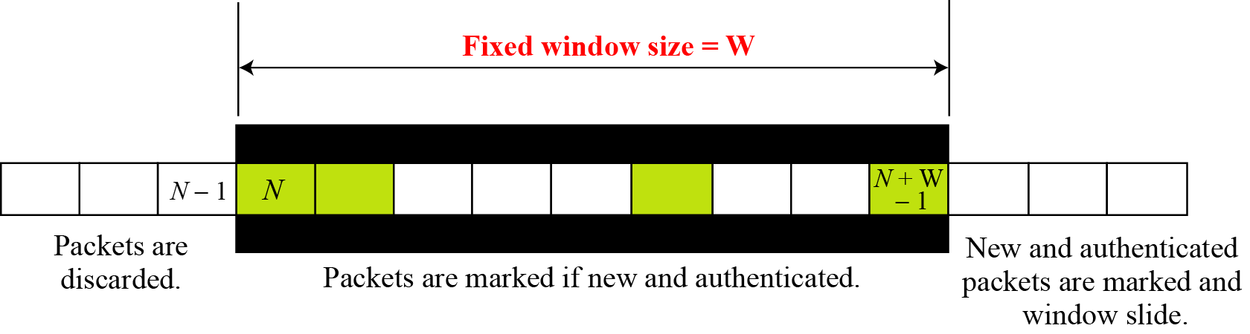
18.2.5 (Continued)
Figure 18.9 Replay window
18.<number>

Slide 21
18-3 SECURITY ASSOCIATION
Security Association is a very important aspect of IPSec. IPSec requires a logical relationship, called a Security Association (SA), between two hosts. This section first discusses the idea and then shows how it is used in IPSec.
Topics discussed in this section:
18.3.1 Idea of Security Association
18.3.2 Security Association Database (SAD)
18.<number>

Slide 22
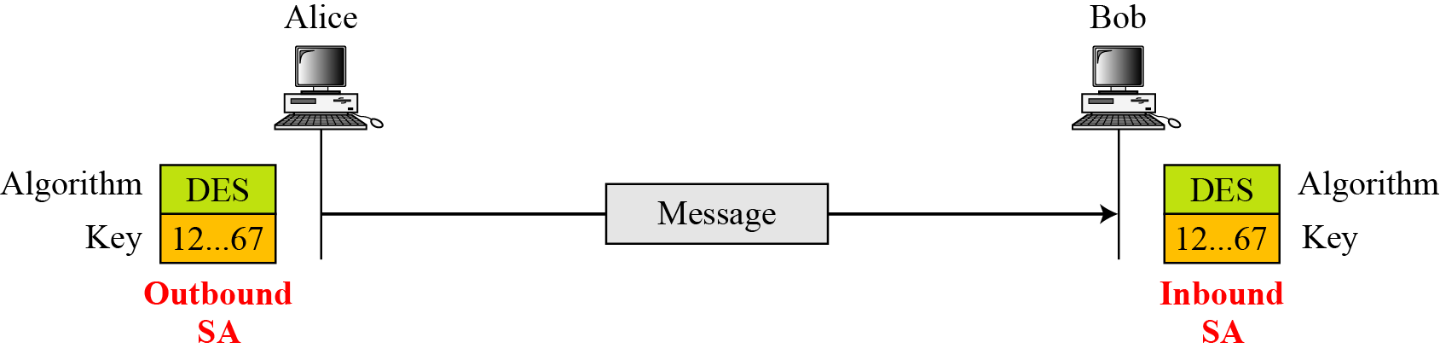
18.3.1 Idea of Security Association
Figure 18.10 Simple SA
18.<number>

Slide 23
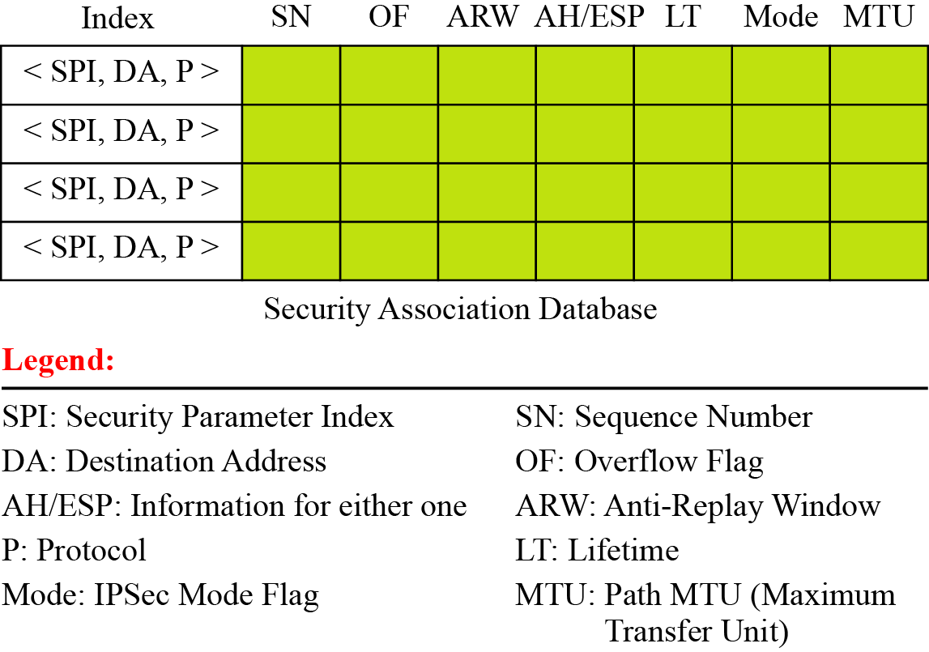
18.3.2 Security Association Database (SAD)
Figure 18.11 SAD
18.<number>

Slide 24
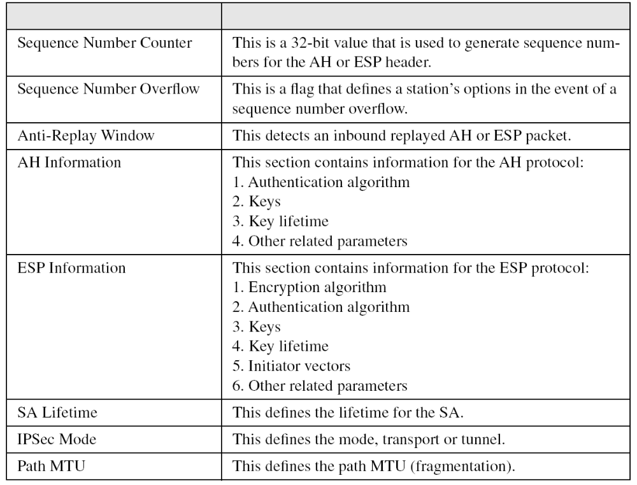
18.3.2 (Continued)
Table 18.2 Typical SA Parameters
Parameters
Description
18.<number>

Slide 25
18-4 SECURITY POLICY
Another import aspect of IPSec is the Security Policy (SP), which defines the type of security applied to a packet when it is to be sent or when it has arrived. Before using the SAD, discussed in the previous section, a host must determine the predefined policy for the packet.
Topics discussed in this section:
18.4.1 Security Policy Database
18.<number>

Slide 26
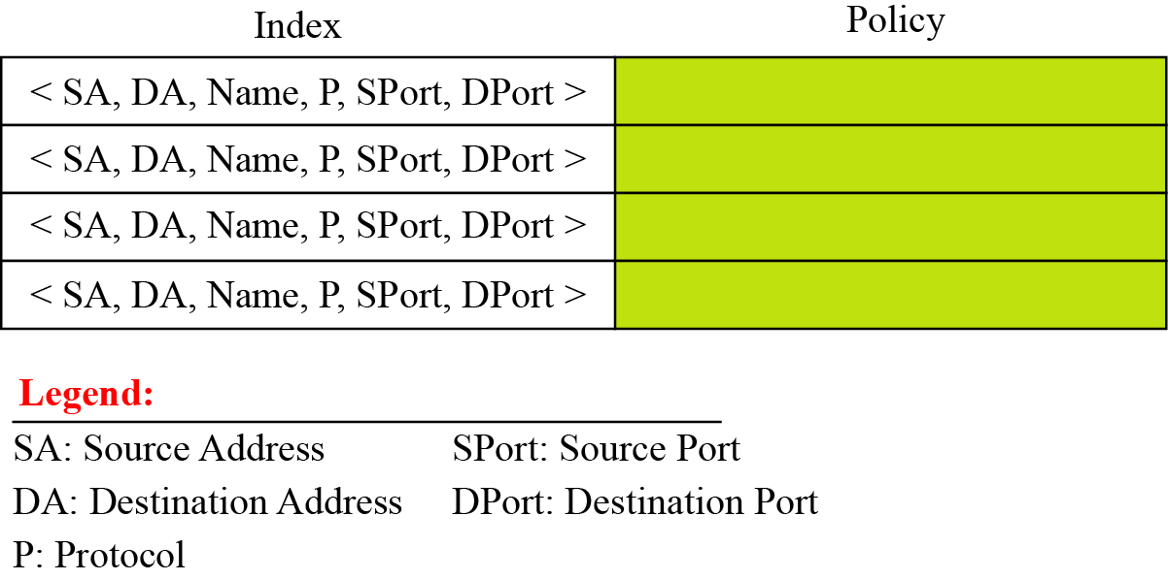
18.4.1 (Continued)
Figure 18.12 Connection identifiers
18.<number>

Slide 27
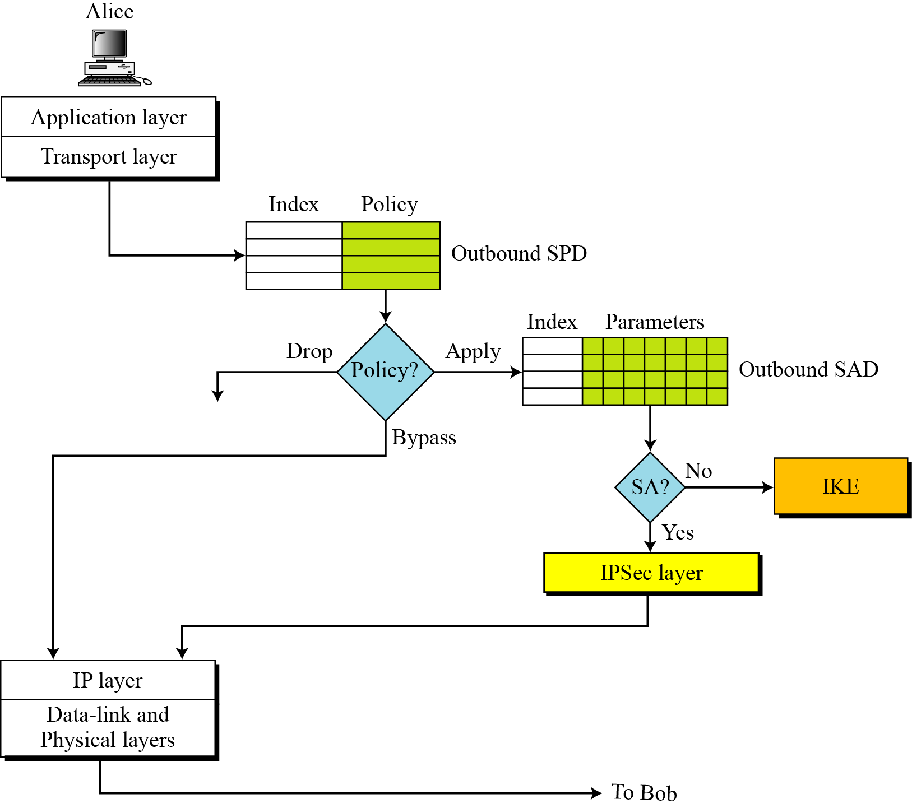
18.4.1 (Continued)
Figure 18.13 Outbound processing
18.<number>

Slide 28
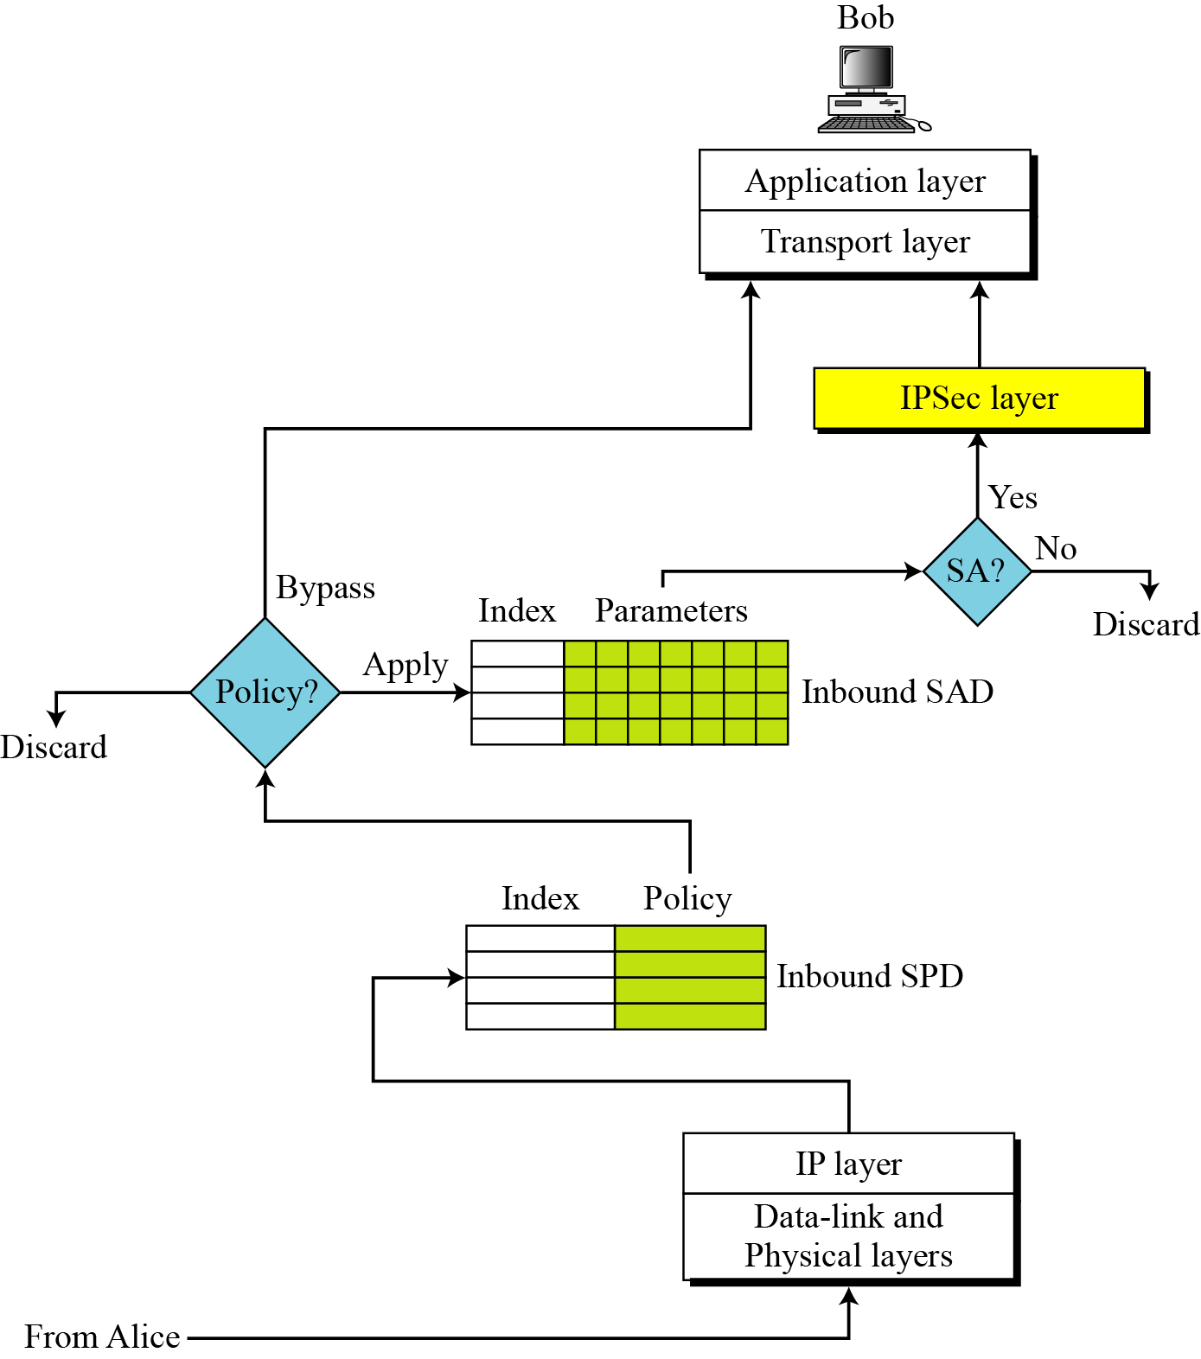
18.4.1 (Continued)
Figure 18.14 Inbound processing
18.<number>

Slide 29
18-5 INTERNET KEY EXCHANGE (IKE)
The Internet Key Exchange (IKE) is a protocol designed to create both inbound and outbound Security Associations.
Topics discussed in this section:
18.5.1 Improved Diffie-Hellman Key Exchange
18.5.2 IKE Phases
18.5.3 Phases and Modes
18.5.4. Phase I: Main Mode
18.5.5 Phase I: Aggressive Mode
18.5.6 Phase II: Quick Mode
18.5.7 SA Algorithms
18.<number>

Slide 30
18.5 (Continued)
Note
IKE creates SAs for IPSec.
18.<number>

Slide 31
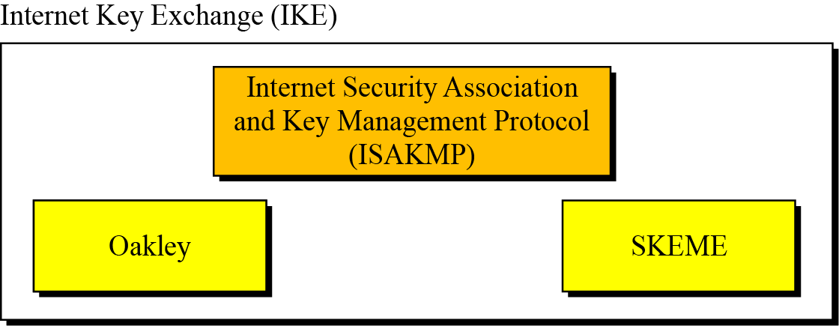
18.5 (Continued)
Figure 18.15 IKE components
18.<number>

Slide 32
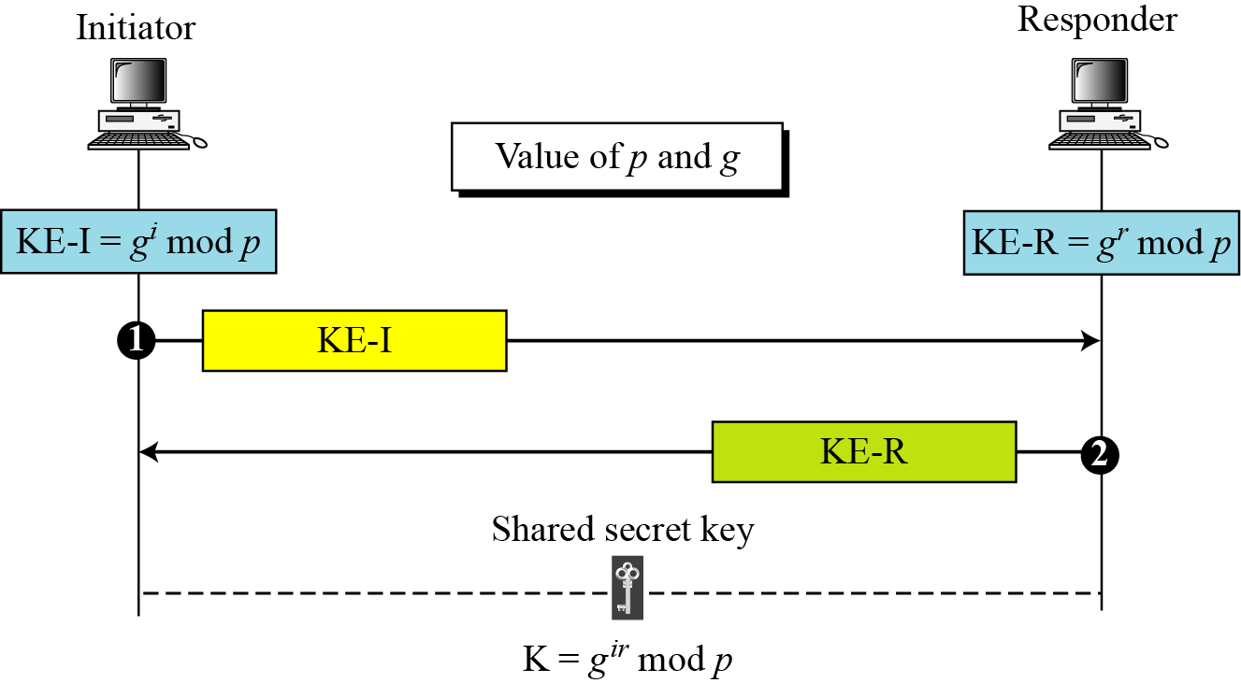
18.5.1 Improved Diffie-Hellman
Figure 18.16 Diffie-Hellman key exchange
18.<number>

Slide 33
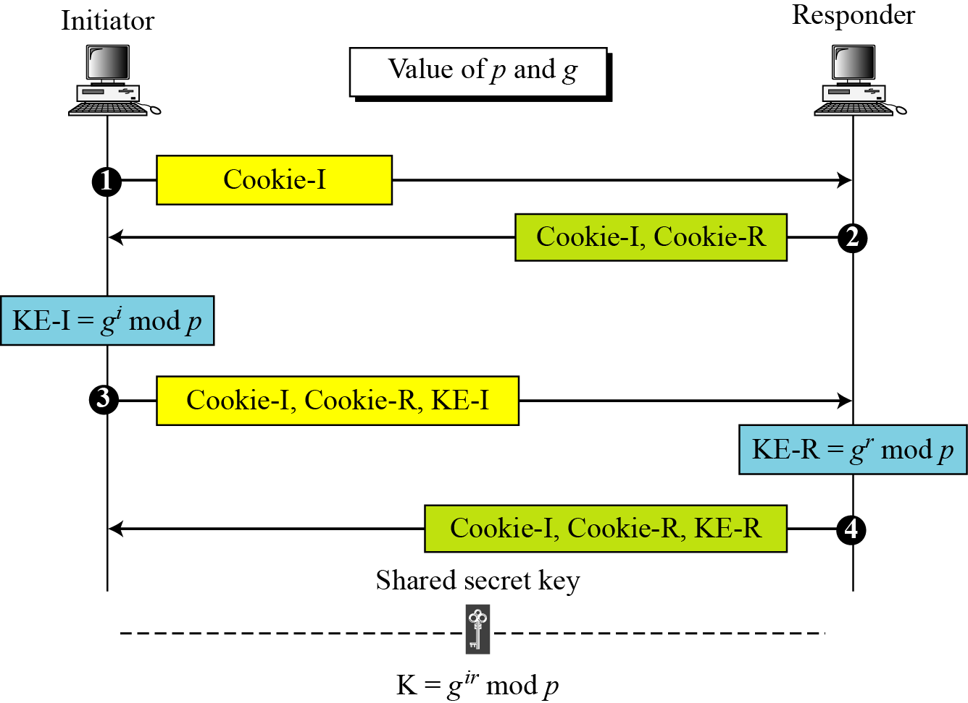
18.5.1 (Continued)
Figure 18.17 Diffie-Hellman with cookies
18.<number>

Slide 34
18.5.1 Continued
Note
To protect against a clogging attack, IKE uses cookies.
Note
To protect against a replay attack, IKE uses nonces.
Note
To protect against man-in-the-middle attack, IKE requires that each party shows that it possesses a secret.
18.<number>

Slide 35
18.5.2 IKE Phases
Note
IKE is divided into two phases: phase I and phase II. Phase I creates SAs for phase II; phase II creates SAs for a data exchange protocol such as IPSec..
18.<number>

Slide 36
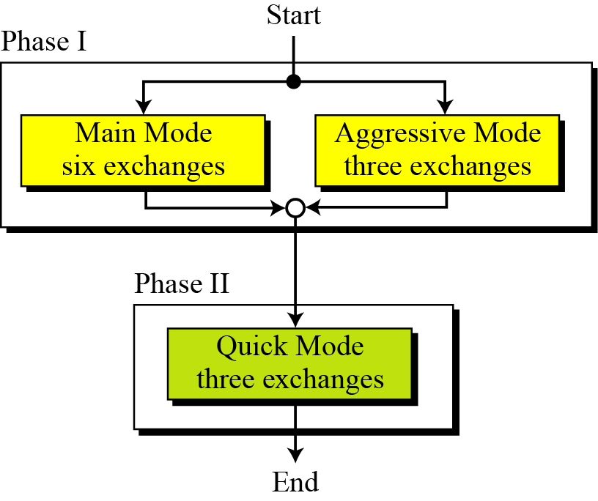
18.5.3 Phases and Modes
Figure 18.18 IKE Phases
18.<number>

Slide 37
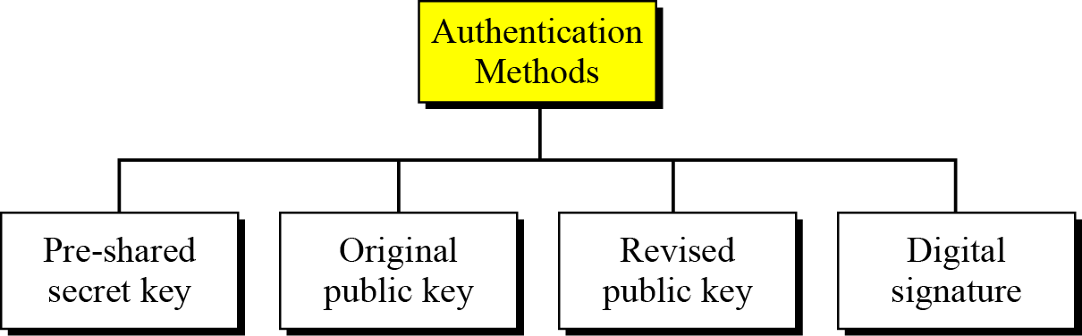
18.5.3 (Continued)
Figure 18.19 Main-mode or aggressive-mode methods
18.<number>

Slide 38
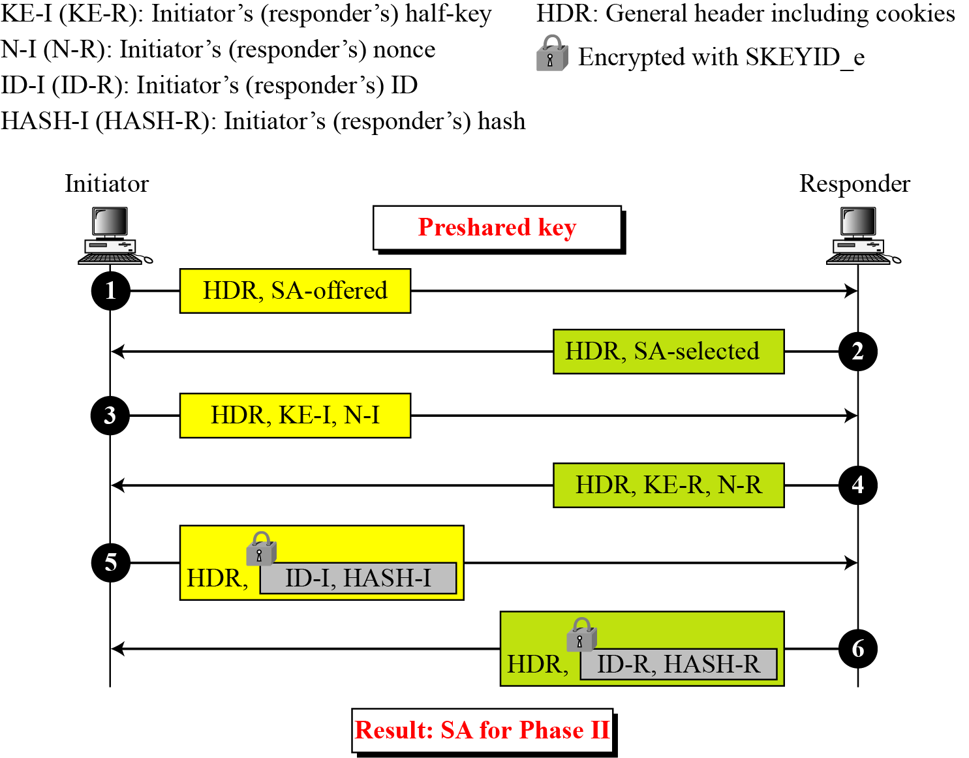
18.5.4 Phase I: Main Mode
Figure 18.20 Main mode, preshared secret-key method
18.<number>

Slide 39
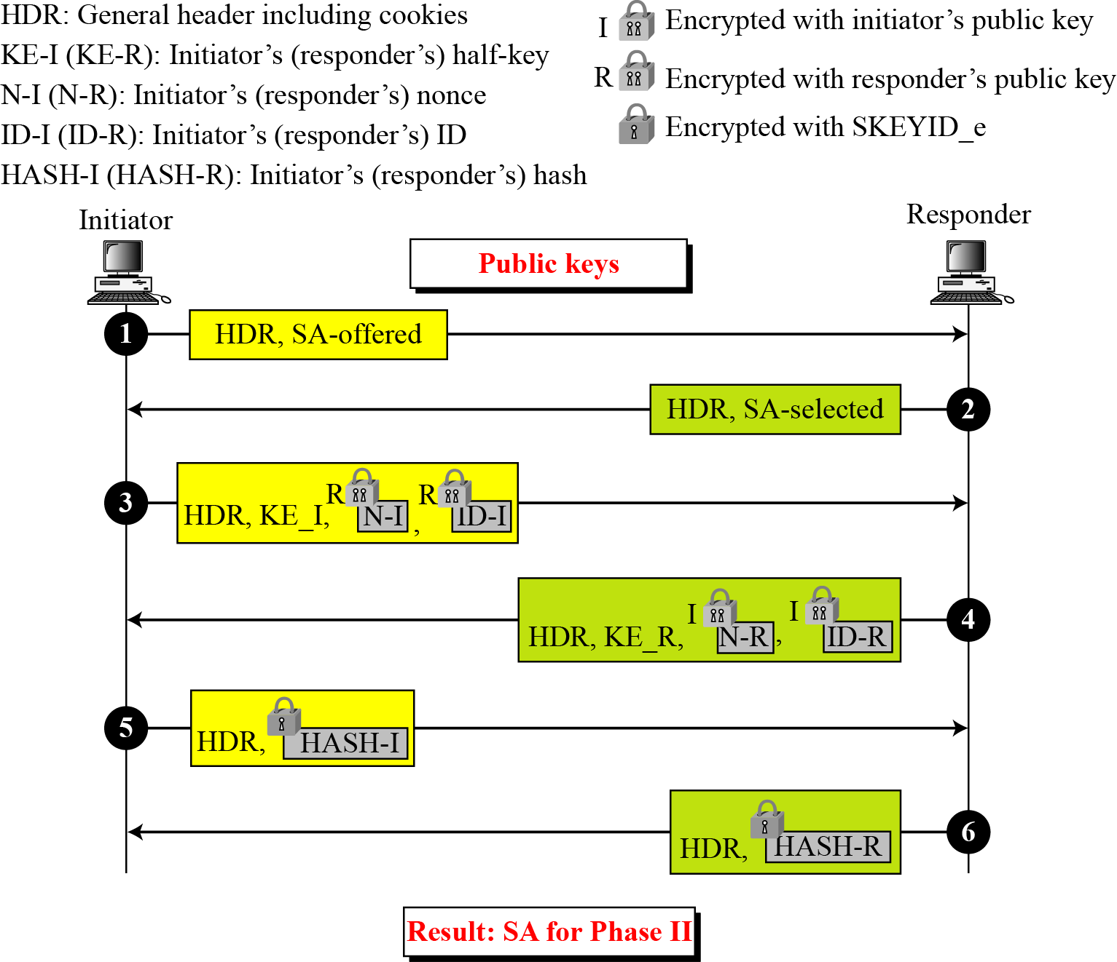
18.5.4 (Continued)
Figure 18.21 Main mode, original public-key method
18.<number>

Slide 40
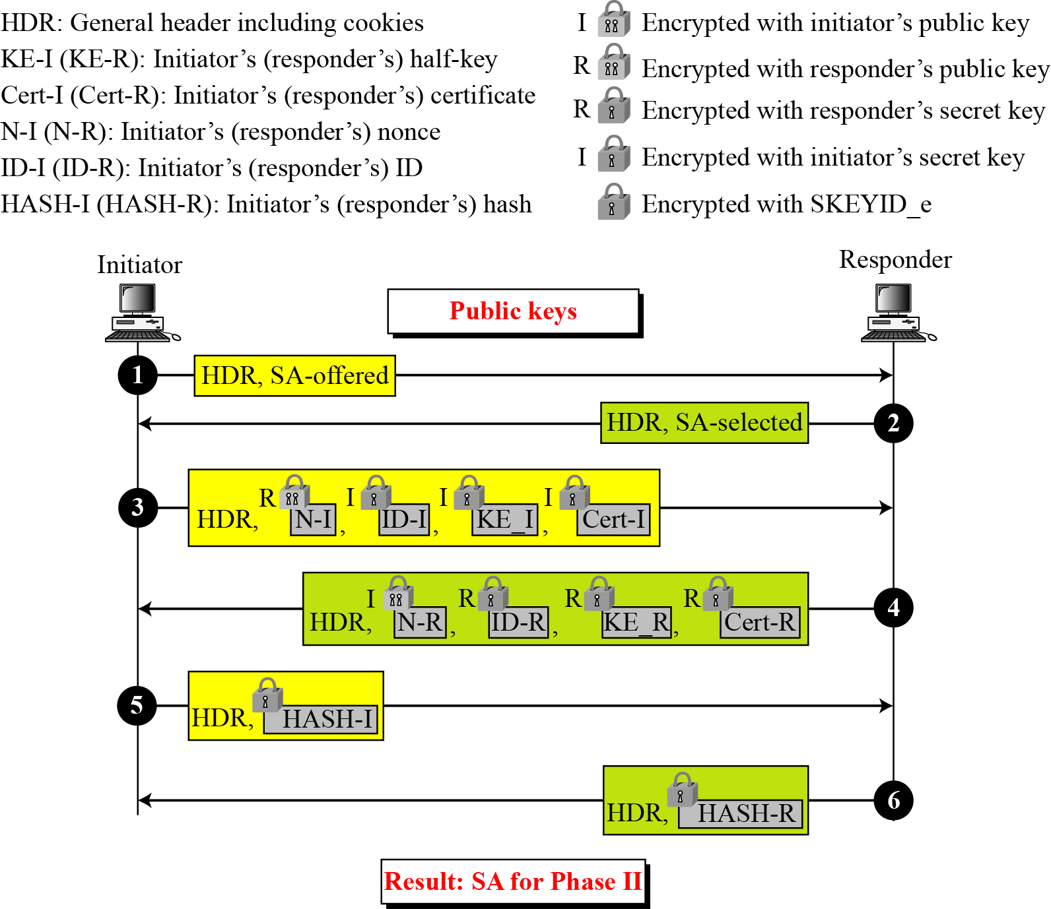
18.5.4 (Continued)
Figure 18.22 Main mode, revised public-key method
18.<number>

Slide 41
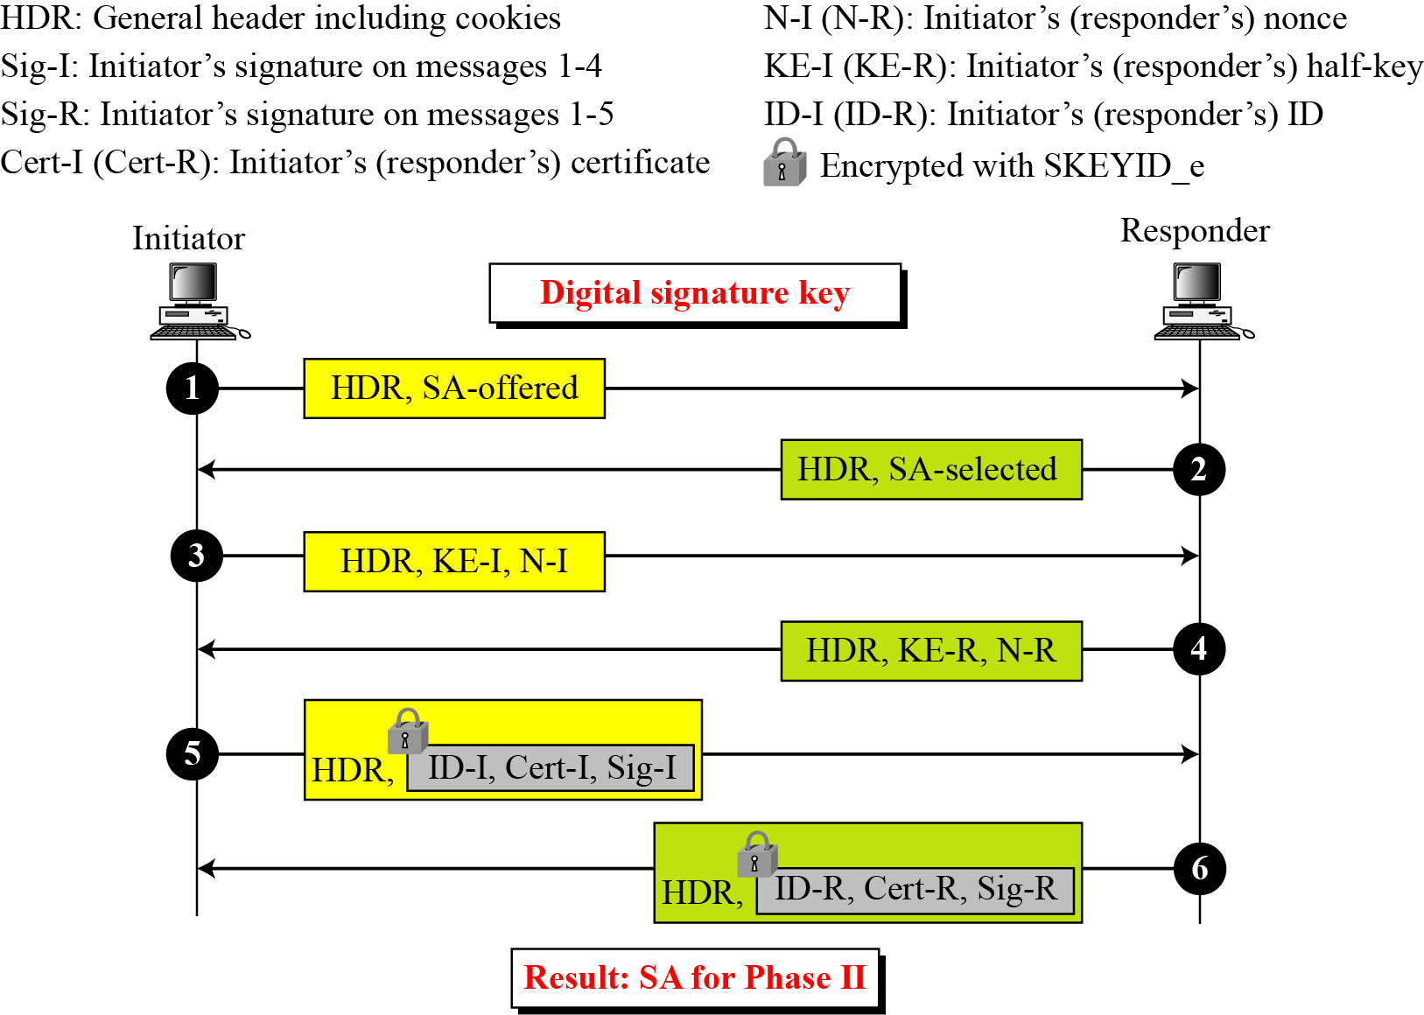
18.5.4 (Continued)
Figure 18.23 Main mode, digital signature method
18.<number>

Slide 42
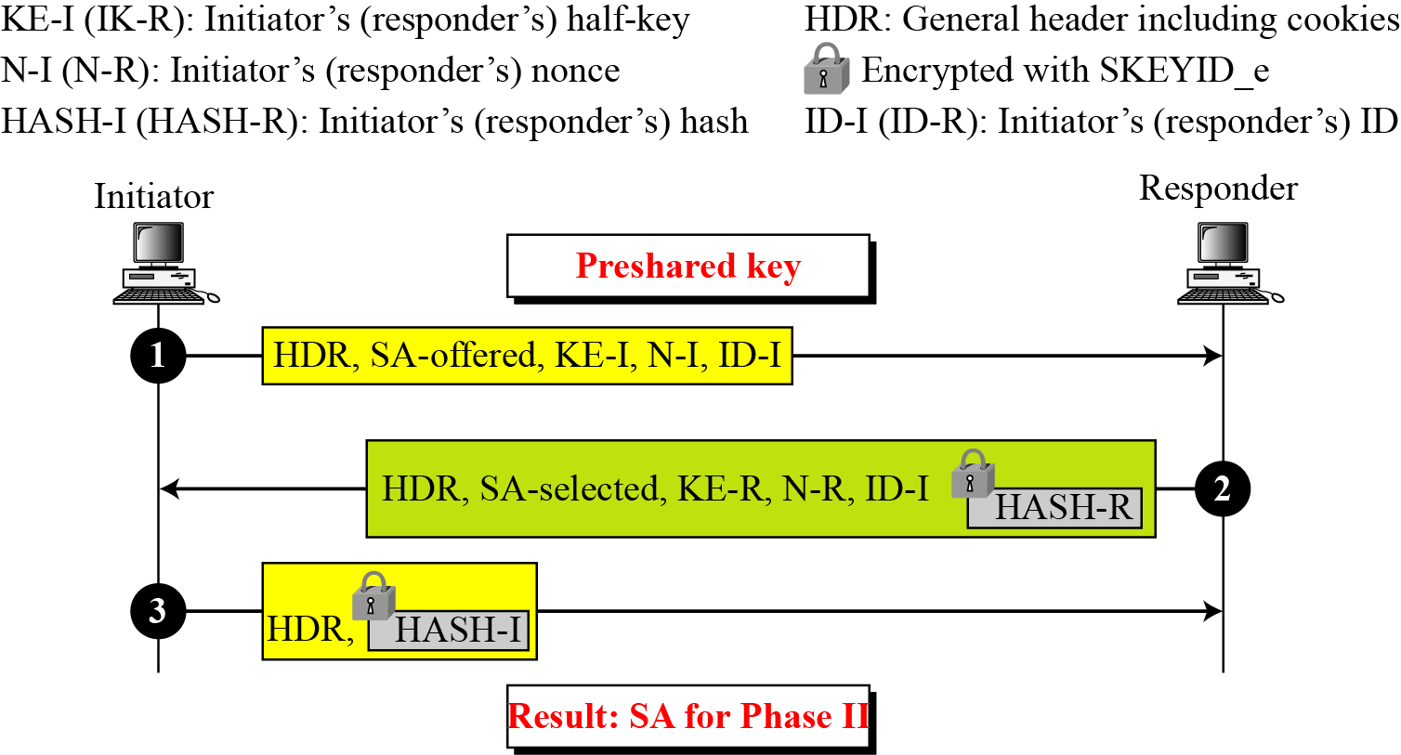
18.5.5 Phase I: Aggressive Mode
Figure 18.24 Aggressive mode, preshared-key method
18.<number>

Slide 43
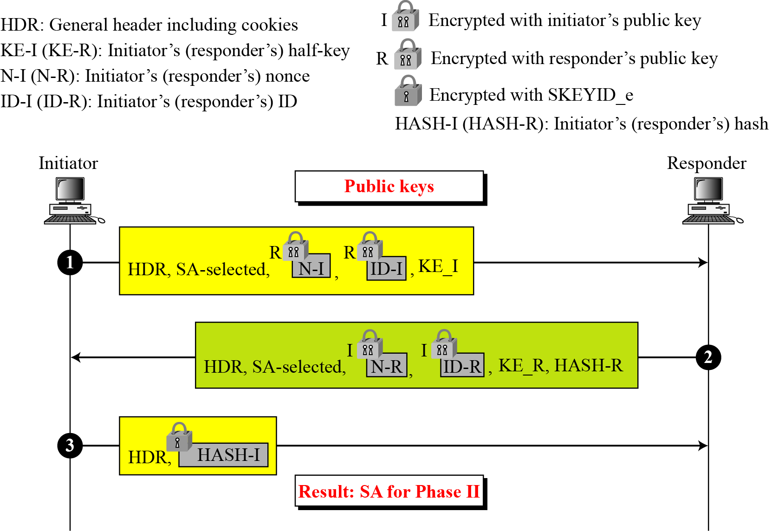
18.5.5 (Continued)
Figure 18.25 Aggressive mode, original public-key method
18.<number>

Slide 44
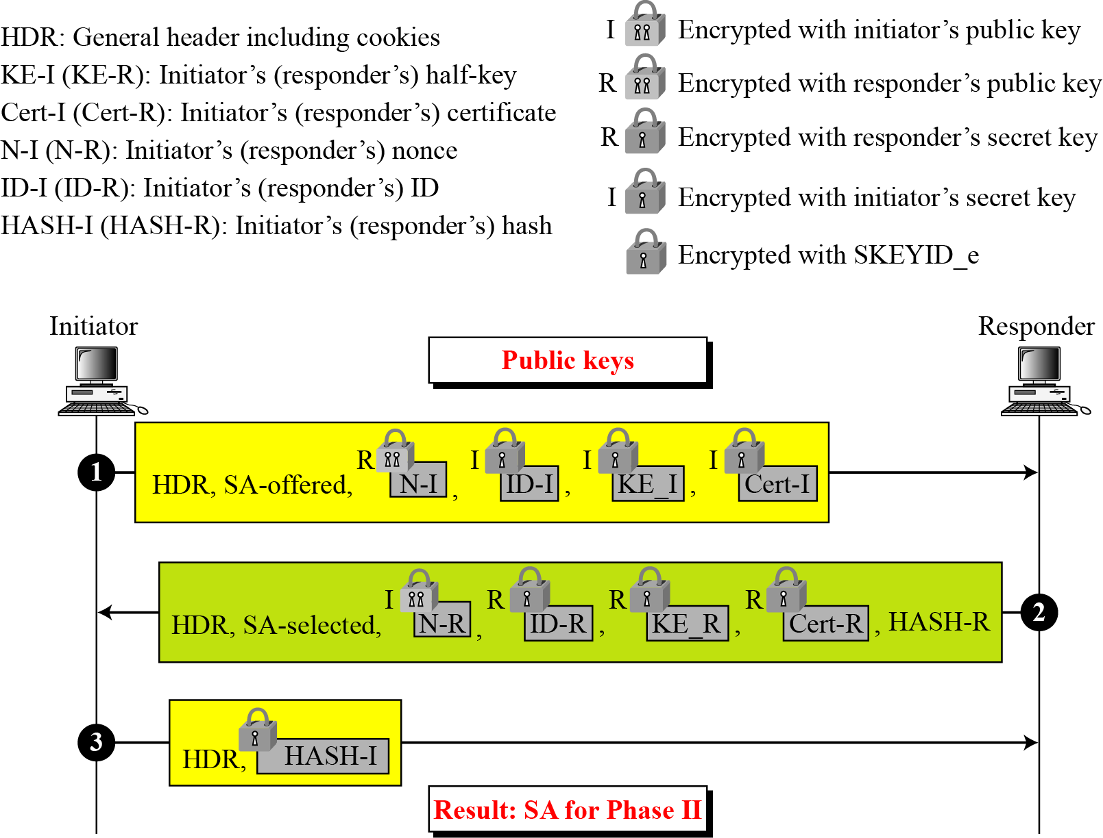
18.5.5 (Continued)
Figure 18.26 Aggressive mode, revised public-key method
18.<number>

Slide 45
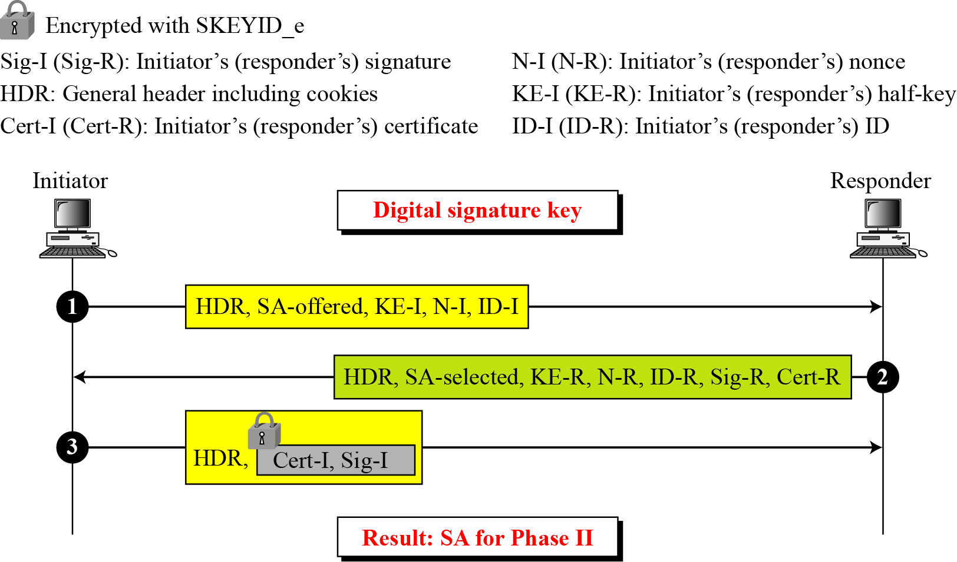
18.5.5 (Continued)
Figure 18.27 Aggressive mode, digital signature method
18.<number>

Slide 46
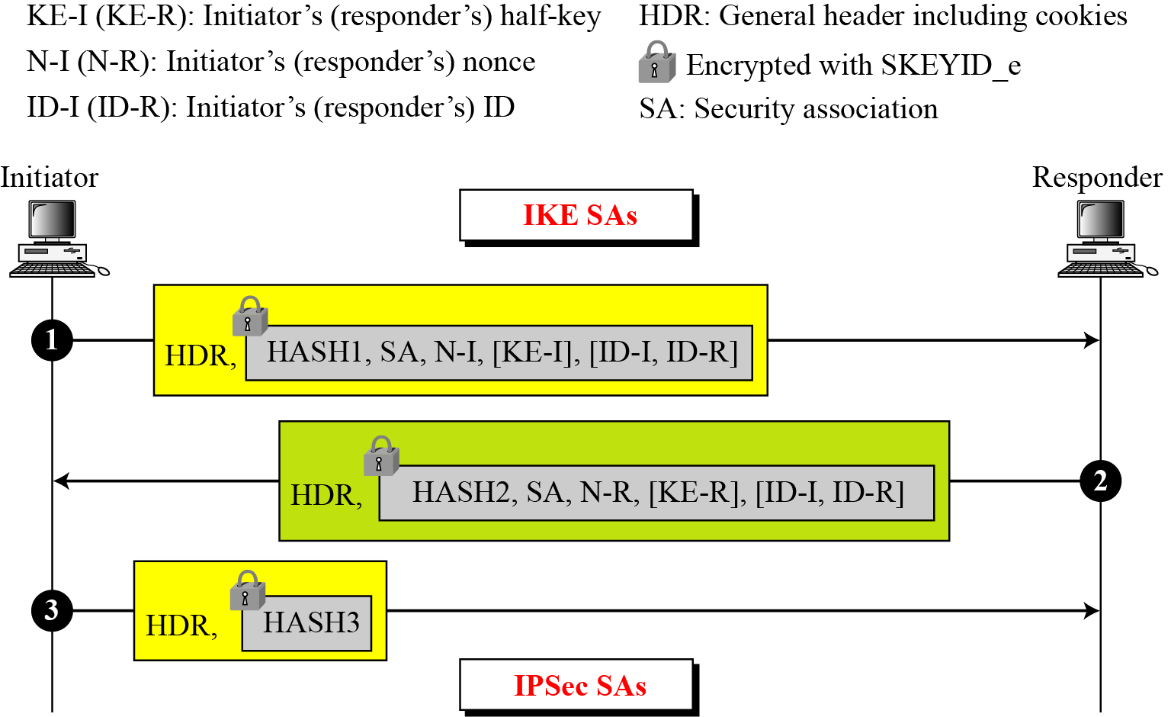
18.5.6 Phase II: Quick Mode
Figure 18.28 Quick mode
18.<number>

Slide 47
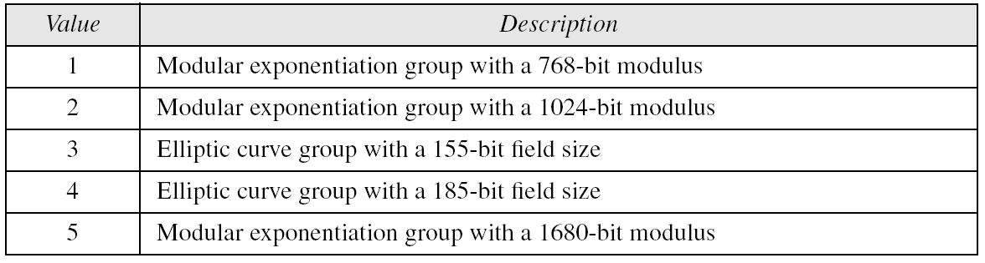
18.5.7 SA Algorithms
Table 18.3 Diffie-Hellman groups
18.<number>

Slide 48
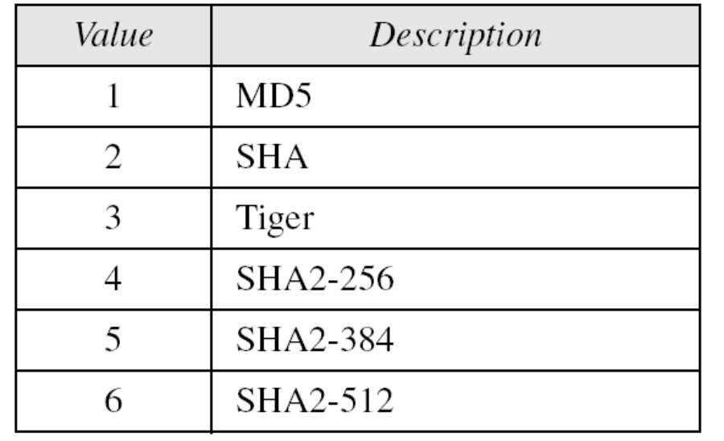
18.5.7 Continued
Table 18.4 Hash Algorithms
18.<number>

Slide 49
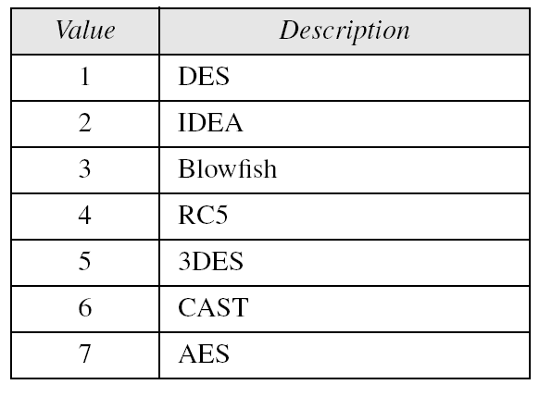
18.5.7 Continued
Table 18.5 Encryption algorithms
18.<number>

Slide 50
18-6 ISKAMP
The ISAKMP protocol is designed to carry messages for the IKE exchange.
Topics discussed in this section:
18.6.1 General Header
18.6.2 Payloads
18.<number>

Slide 51
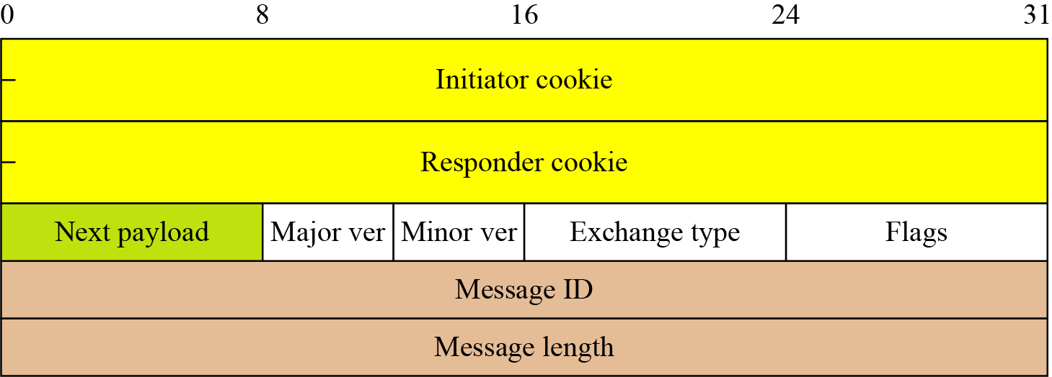
18.6.1 General Header
Figure 18.29 ISAKMP general header
18.<number>

Slide 52
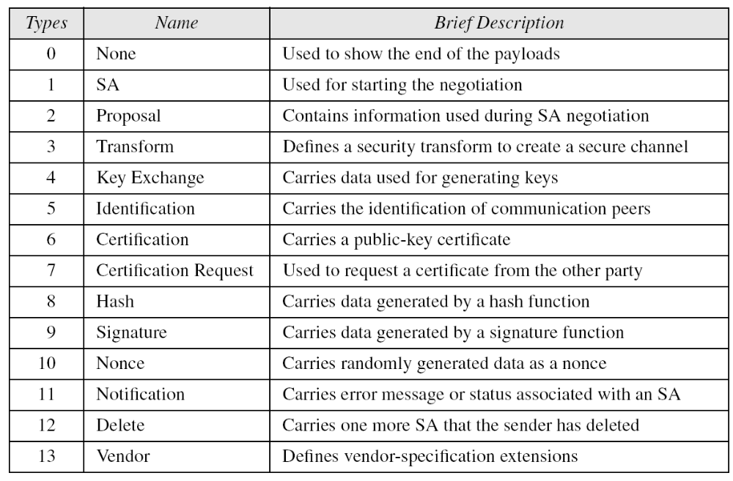
18.6.2 Payloads
Table 18.6 Payloads
18.<number>

Slide 53
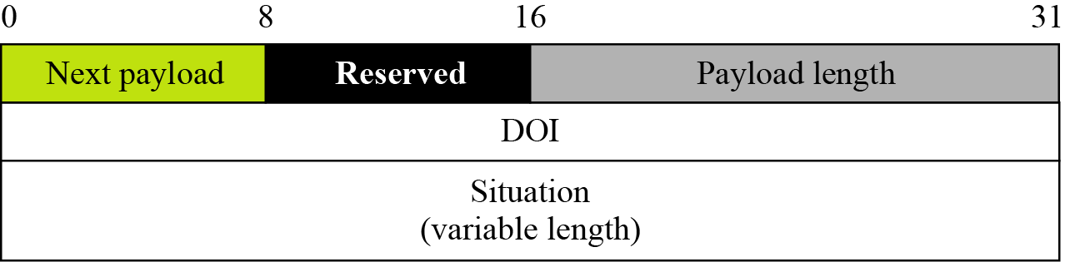
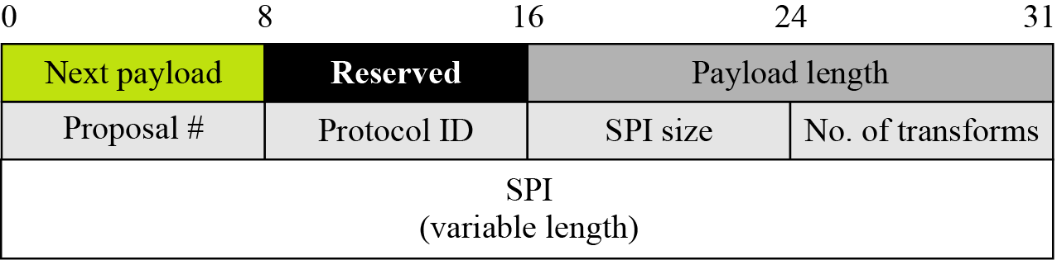
18.6.2 (Continued)
Figure 18.30 Generic payload header
Figure 18.31 SA payload
DOI - Domain of Interpretation
Figure 18.32 Proposal payload
18.<number>

Slide 54
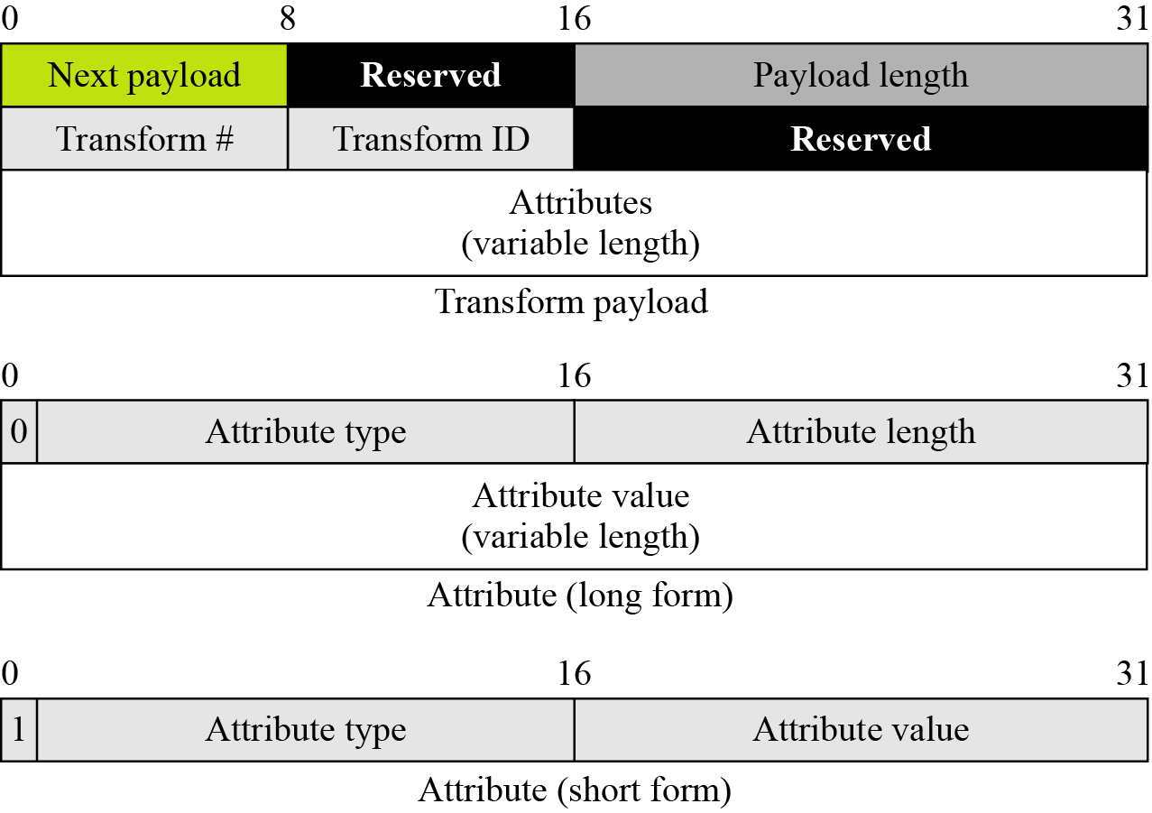
18.6.2 (Continued)
Figure 18.33 Transform payload
18.<number>

Slide 55
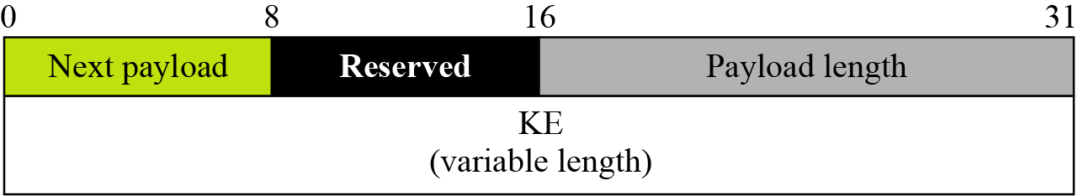
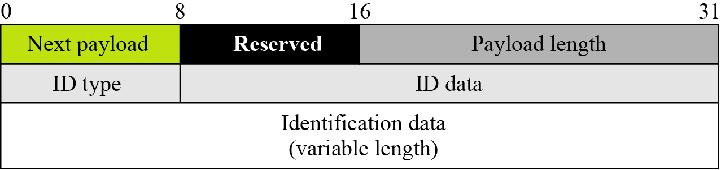
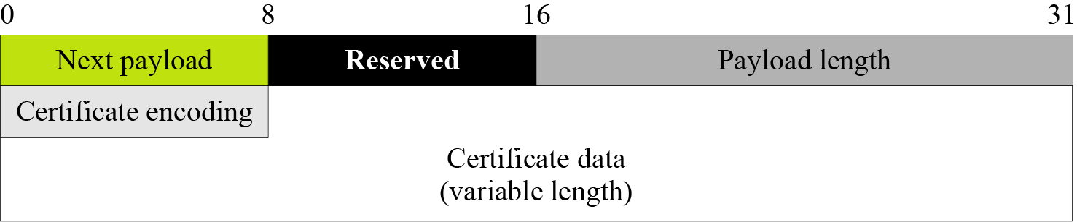
18.6.2 (Continued)
Figure 18.34 Key-exchange payload
Figure 18.35 Identification payload
Figure 18.36 Certification payload
18.<number>

Slide 56
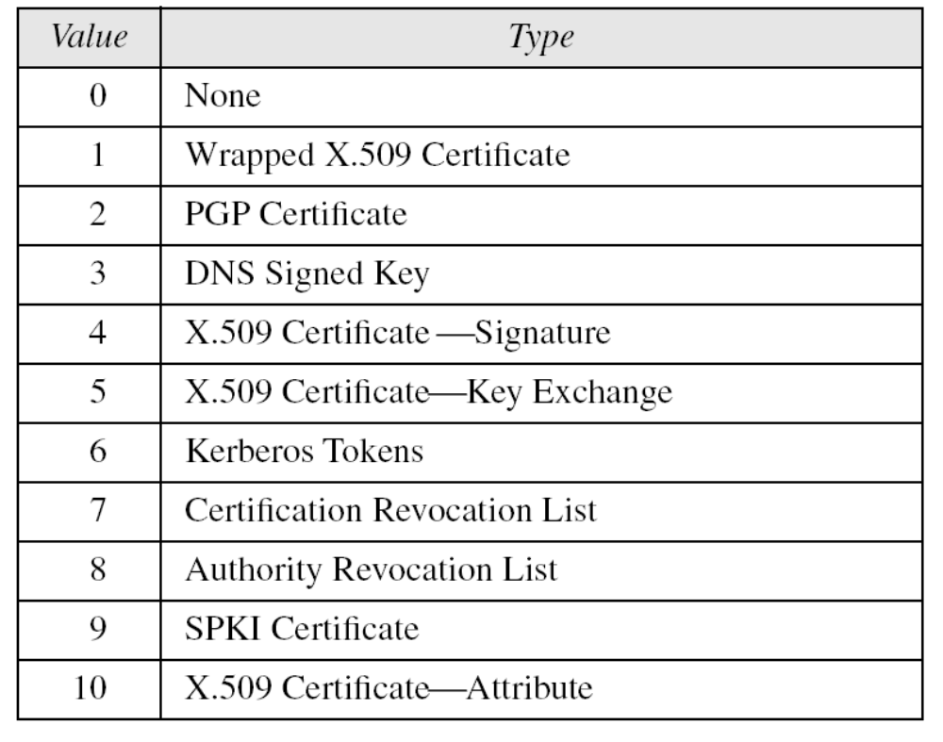
18.6.2 Continued
Table 18.7 Certification types
18.<number>

Slide 57
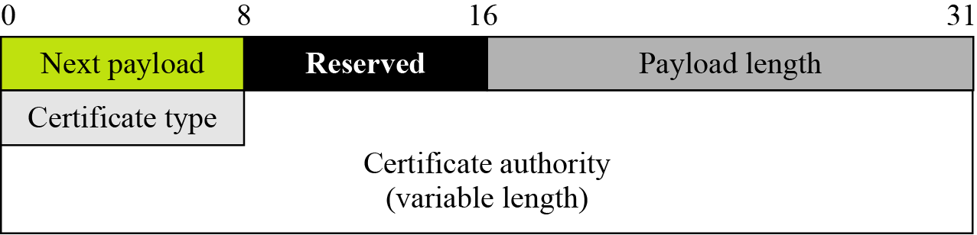
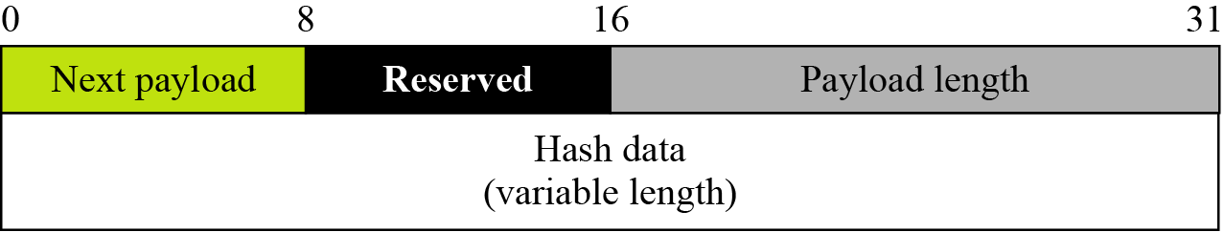
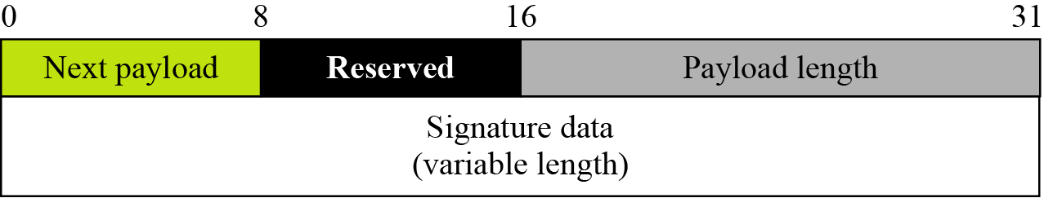
18.6.2 (Continued)
Figure 18.37 Certification request payload
Figure 18.38 Hash payload
Figure 18.39 Signature payload
18.<number>

Slide 58
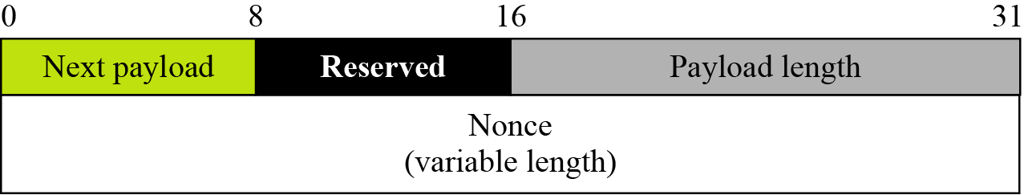
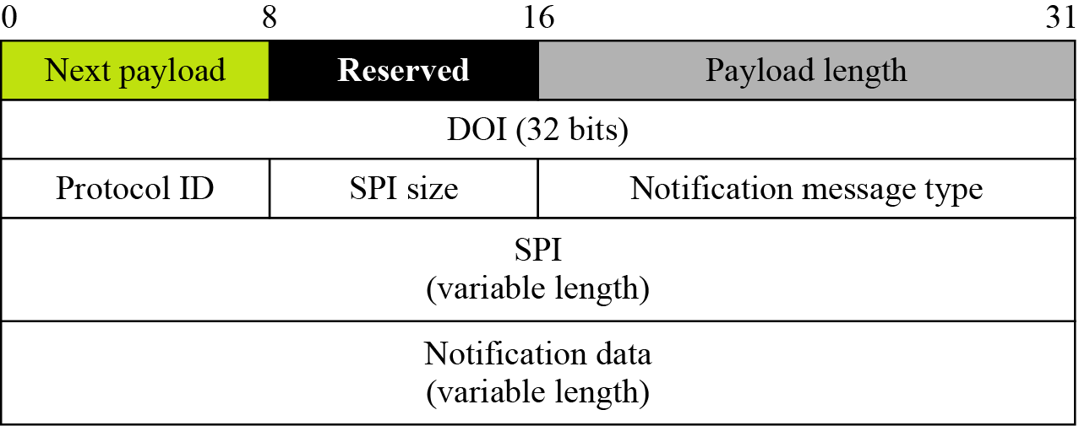
18.6.2 (Continued)
Figure 18.40 Nonce payload
Figure 18.41 Notification payload
18.<number>

Slide 59
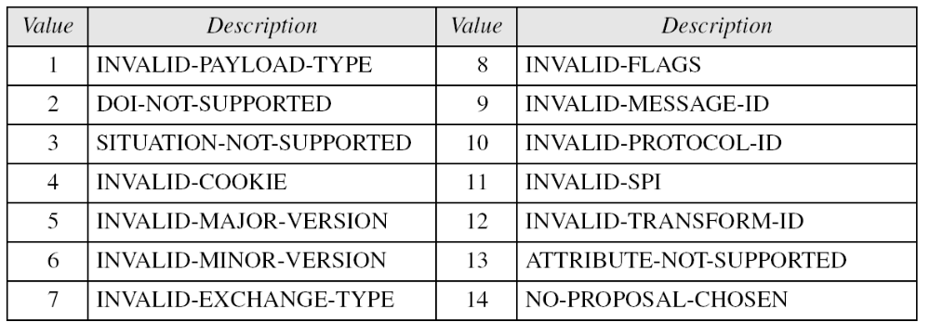
18.6.2 Continued
Table 18.8 Notification types
18.<number>

Slide 60
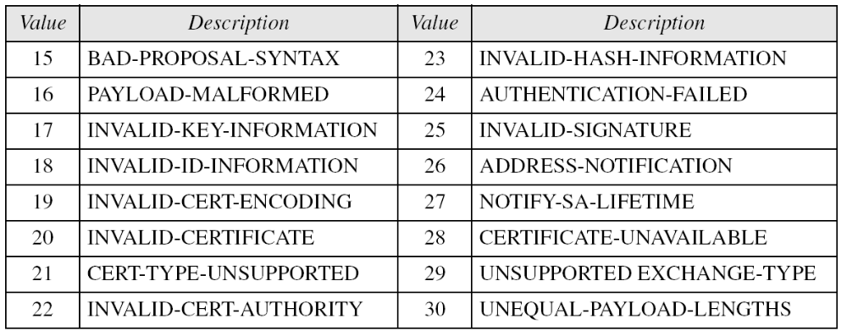
18.6.2 Continued
Table 18.8 Notification types (Continued)
18.<number>

Slide 61
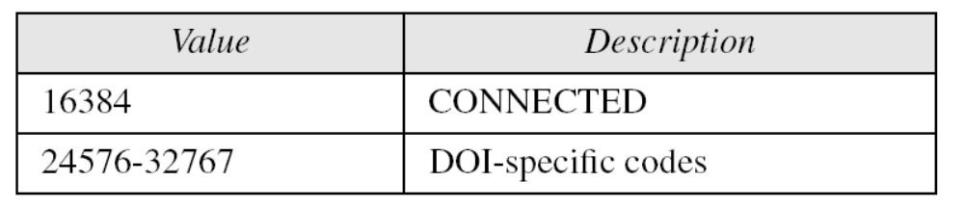
18.6.2 Continued
Table 18.9 Status notification values
18.<number>

Slide 62


18.6.2 Continued
Figure 18.42 Delete payload
Figure 18.43 Vendor payload
18.<number>

